Slide 1
Jinal Chhajed
Skill Assessment and it’s Importance
Under-graduating B.tech student in IT.
Rescinded intern at Boeing and now working with a start-up named FORTE HACK.

Slide 2
Jinal Chhajed
Skill Assessment and it’s Importance
Under-graduating B.tech student in IT.
Rescinded intern at Boeing and now working with a start-up named FORTE HACK.
Learning cyber security at the core .

Slide 3
Jinal Chhajed
Skill Assessment and it’s Importance
Under-graduating B.tech student in IT.
Rescinded intern at Boeing and now working with a start-up named FORTE HACK.
Learning cyber security at the core .
I have seen many failures while exploring things around last 19 years major of my which includes getting admission in IIT ,a failed start-up, and then again hard luck with this Boeing thing and now again looking hopefully towards cyber world.

Slide 4
Studied really hard for 2 years in hope of getting admission in IIT somehow .But failed in Jee-Advance . Reason- I focused only on solving and studying for Advance(next level )before thinking of the mains(start level) and also limited myself to a subject (Chemistry)

Slide 5
Studied really hard for 2 years in hope of getting admission in IIT somehow .But failed in Jee-Advance . Reason- I focused only on solving and studying for Advance(next level )before thinking of the mains(start level). And I learned My very first lesson of life – Focus on your start first. Step by Step, Little by little move on .Don’t Jump on to the final destination directly . Lesson 2 – Don’t limit yourself .Learn everything .

Slide 6
In 2018 got an idea and motivation for start-up. Studied a lot about it and finally decided to start an eco-friendly start-up and applied for the same in Eaton’s i2i(ignited innovators of India )under Humanity and health sector.Got my team up and we cleared all the initial rounds of pitching the idea,Presenting it ,Gettig sponsorship and mentor for the same from Eaton itself and to the final round where we were asked to apply in to a specific area ,we failed there !

Slide 7
Reason-Lack of perseverance and Lack of support from people. Lesson’s learned –Always be a team player and develop leadership skills and the most important be ready to face 100s of rejection.

Slide 8
2019 –After putting in many efforts and waiting for a whole day to give a 50 minutes interview ,I was finally offered internship letter from Boeing for joining in as Application developer . 2020- Got a call from Boeing saying sorry for not being able to conduct virtual internship !!

Slide 9
Lesson learned –Be prepared to face any consequence that life gives you . Changed many fields but common things in all these situations were my urge to develop skills that I already have and also the ones I don’t possess. 2020-Happy to work with Forte Hack as a web developer and also pursue my specialisation in White hat hacking.

Slide 10
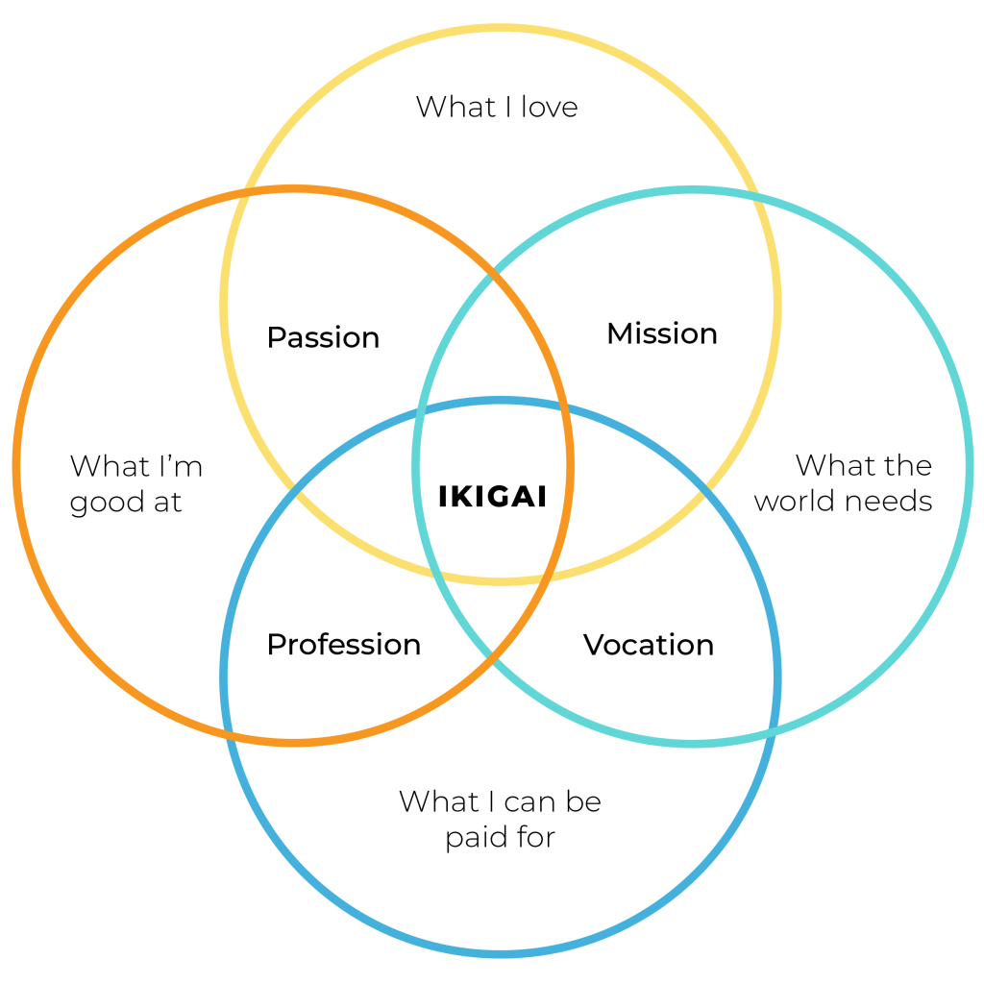
Introduction

Slide 11
What is Skill and Skill Assessment?
Skills are what you get when you put in your efforts , hardwork and develop them with continuous practice.

Slide 12
What is Skill and Skill Assessment?
Skills are what you get when you put in your efforts , hardwork and develop them with continuous practice.
Skill assessment is the mostly widely applied means to review/check on your skills .

Slide 13
What is Skill and Skill Assessment?
Skills are what you get when you put in your efforts , hardwork and develop them with continuous practice.
Skill assessment is the mostly widely applied means to review/check on your skills
The best trained people in room are not always the best .They may not run company or society well.

Slide 14
Why is it important ?
While recruiters recruit for some position they see a pool of people with same talent .It’s a rat race.
Employees are their asset.

Slide 15
Why is it important ?
While recruiters recruit for some position they see a pool of people with same talent .It’s a rat race.
Employees are their asset.
They review you based on your skills. It may be in many forms like panel interview, soft-skill assessment, case study, written tests etc.

Slide 16
What does this skill-set include?
Depends on Company and the position you applied for .
Skill is an infinite set.
According to studies a person on average changes his career 4/5 times in a life .Train yourself not only for first job .Think about 4th or 6th ones.

Slide 17
What does this skill-set include?
Depends on Company and the position you applied for .
Skill is an infinite set.
According to studies a person on average changes his career 4/5 times in a life .Train yourself not only for first job .Think about 4th or 6th ones.
Basic skill set –Soft skills,Technical knowledge, Loyalty,Diversity.

Slide 18
I read it somewhere few days ago : “Master one skill in 20’s and enjoy and earn rest of your life.” What if the one we mastered in 20s got outdated in 30s ? - 20% to the 4 skills that you really want to master and 20% to get updated with the another ones. Don’t be one-trick-pony.

Slide 19
I read it somewhere few days ago : “Master one skill in 20’s and enjoy and earn rest of your life.” What if the one we mastered in 20s got outdated in 30s ? - 20% to the 4 skills that you really want to master and 20% to get updated with the another ones.
Don’t be one-trick-pony.
Make choices .Take risks.

Slide 20
Soft Skills
Soft skills are skills of problem solving , thinking creatively, communicating clearly and sensitively, building trust , acting ethically .
Tool to navigate in 21st century.
Teachable , Measurable , Important.
When it comes to jobs soft skills are most looked into for long run.

Slide 21
Common Soft Skills
Excellent Communicator and Presentor
– Service based economy.
Take part in events.Join NGO’s ,Clubs -AICVS,TedxCummins,Codeclub
Reach out to people .Talk to them.
Read more and more .(Ikigai-Hector Gracia, Influencer-Kerry petterson,Daily newpapers etc.)
Watch movies ,Hollywood series, Talks .

Slide 22
Common Soft Skills
Team player –
Be active
Look at everything with perspective of learning and not earning .
Be humble and clear with things .

Slide 23
Common Soft Skills
Leadership –
Going forward along with your team.
Take up new projects.
Be dynamic .Don’t stick to one thing .
Listener.

Slide 24
Common Soft Skills
Positive attitude
Perseverance
Willingness to put in all you have
There are thousands of such skills that you can build by .All you need is little effort and Very little Smartness to always find a way out (Google and youtube are there to help you out !)

Slide 25
How does this affect placement?
General policy of skill assessment :
Apply for a company

Slide 26
How does this affect placement?
General policy of skill assessment :
Apply for a company → Take up skill test
Note: Start here. Take time .Study it completely and Give the test patiently.

Slide 27
How does this affect placement?
General policy of skill assessment :
Apply for a company → Take up skill test →Technical rounds→Interview → HR.

Slide 28
Importance of Diversity and Misconceptions
Be diverse to take up opportunities .
Diversity in career and workplace is much preferred by companies .

Slide 29
Importance of Diversity and Misconceptions
Be diverse to take up opportunities .
Diversity in career and workplace is much preferred by companies .
Don’t narrow your set of diversity in skill set.

Slide 30
Q&A
Strive for progress and not for perfection.
Add up everyday little by little !!
Linked-in – https://www.linkedin.com/in/jinal-chhajed-3a4839171
Email - jinal.chhajed@cumminscollege.in

